Slide 1
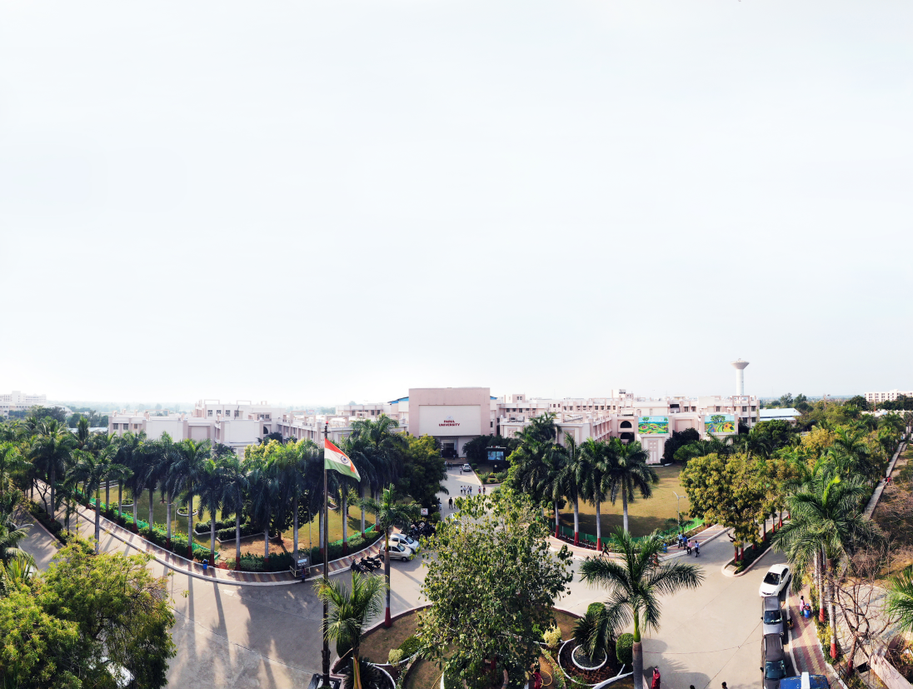


Generics Programming
Prof. Priya Pati, Assistant Professor
Computer Science & Engineering

Slide 2
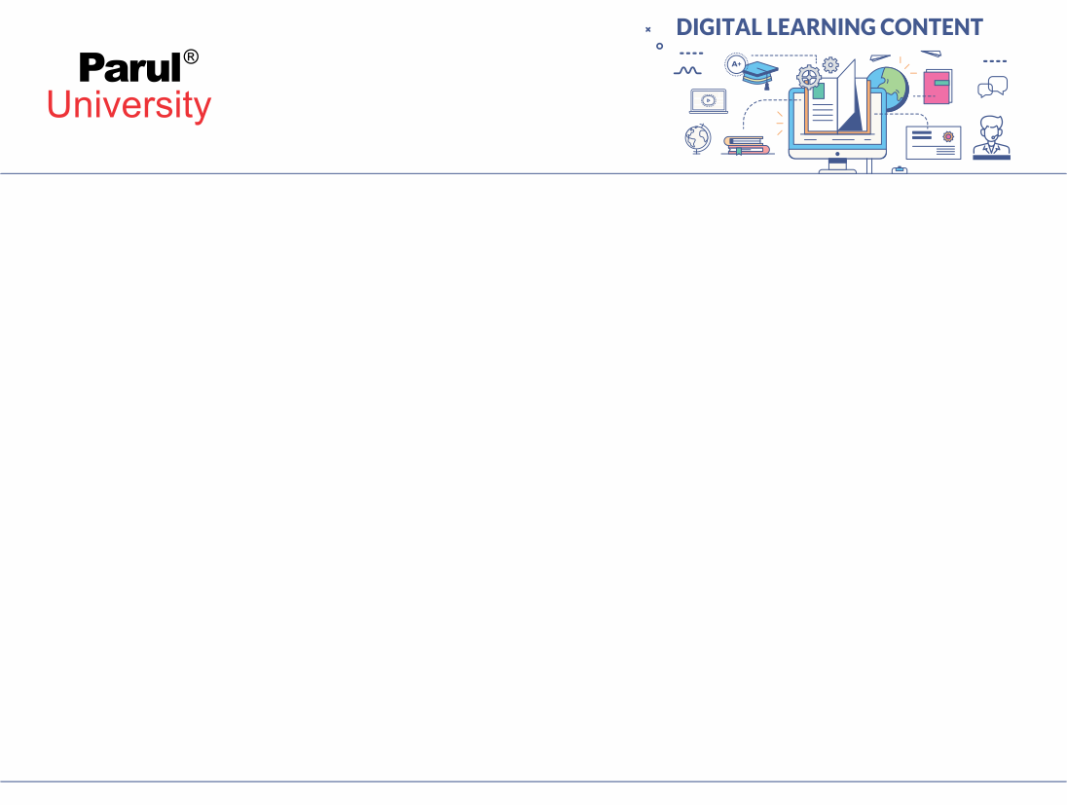

CHAPTER-4
Generics Programming

Slide 3
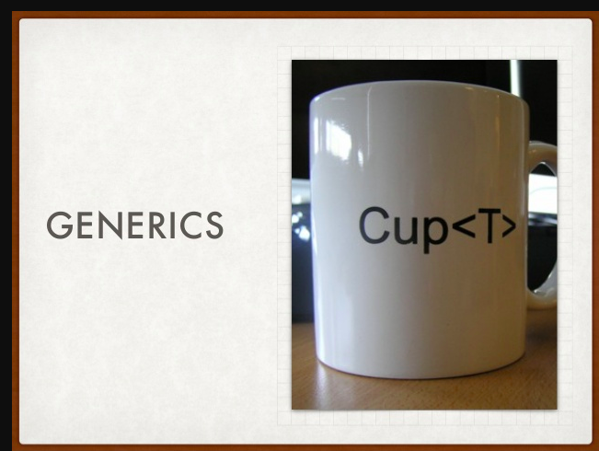
What is Generics Programming?
• According to dictionary :”That which is not specific or in general”
In Computer Science : “Type to be specified later”
The example below showing a cup, which can hold either tea, coffee or water, nothing in particular.Same with generic programming which can hold any type.
Image source : Google

Slide 4
Generics Programming

Slide 5
INTRODUCTION
Similar to Template in C++
Introduced in J2SE 5 to deal with type safe objects.(Type checking)
Detects bugs at compile time and makes the code stable.
Programming with classes and methods which are parameterised with types.
Any type of objects in the collection can be stored using Generics Programming.

Slide 6
Generics Understanding
List list=new ArrayList(); list.add(“Hello”); list.add(new Float(2.5)); for(Object o : list) { // ClassCastException at run time String str=(String) obj;
}
List<String>list= newArrayList<String>();
list.add(“Hello”);
list.add(new Float(2.5));//Compile time error

Slide 7
Continued…
for(String s:list)
{
//avoids ClassCastException
}
After Java 5,collection classes were used as above.
At the time of creation of List, type of elements of the list is well specified and that is String.
Any other type of object if added then compile time error will be there.
No typecasting is allowed hence no ClassCastException too.

Slide 8
Java Generic Class
public class Gen<T>{ private T t1; public T get(){ return this.t;}
public void set(T t1){ this.t1=t1;}
public static void main(string args[]){
Gen<String> type=new Gen<>();
Type.set(“Hello”); Gen ty=new Gen(); ty.set(10); //valid }}
Image source : Google

Slide 9
Generic Class
Generics Type <T> should be parametrized
Auto boxing is supported.
If no type is provided then the warning messages will be produced stating that it is raw type.
As type is not provided it becomes an Object which supports Integer and String objects.

Slide 10
Java Generic Method
Public class GenMethod {
public static <T> boolean isEqual(GenericsType<T> s, GenericsType<T> ss){return s.get().equals(ss.get());}
public static void main(String args[]){
GenericsType<String> s = new GenericsType<>();
s.set("Hello");
GenericsType<String> ss = new GenericsType<>();
ss.set("Hello");
boolean isEqual = GenericsMethods.<String>isEqual(s,ss);
//above statement can be written simply as
//This feature, known as type inference, allows you to invoke a generic method as an ordinary method, without specifying a type between angle brackets.
//Compiler will infer the type that is needed
}
}

Slide 11
Java Generics Method
isEqual = GenericsMethods.isEqual(s, ss);
//type inferencing is done.
}
If whole class is not to be parameterized,only method can be created.
Generics type constructor can also be created.
Declaration of generic method that is enclosed within a non generic class.

Slide 12
Generic Code and Virtual Machine
Java virtual machine has no concept of generic types or methods.
Generic classes and methods turn into ordinary classes and methods by erasing the type variables.
Type variables are erased ,producing a raw type.
Example: The raw type for Pair<T> is reflected this way:
public class Pair
{
public Pair(Object first, Object second)
{
}
publicObject getFirst() { return first; }
publicObject getSecond() { return second; }
public void setFirst(Object newValue) { first = newValue; }
public void setSecond(Object newValue) { second = newValue; }
privateObject first;
privateObject second;
}

Slide 13
this.first = first;
this.second = second;
}
publicObject getFirst() { return first; }
publicObject getSecond() { return second; }
public void setFirst(Object newValue) { first = newValue; }
public void setSecond(Object newValue) { second = newValue; }
privateObject first;
privateObject second;
}

Slide 14
Generics
Generics are powerful extension to Java.
Creates type safe and reusable code.
Generic exception classes is not created hence it cannot extend Throwable.
Static generic methods can be declared.

Slide 15
Exception Handling

Slide 16
What are Exceptions?
A Java exception is an object which describes an exceptional condition.
The exception object wraps an event which contains the information about the error, the program state when the error occurred and other custom information
When an exception occurs, the program halts and JRE looks for the exception to be thrown.
Thus, an exception object can be thrown and caught.
It handles the run time errors so that the flow of the application is maintained.

Slide 17
Exception-Handling
To understand exception which can be managed by the following keywords:
try :Program statements which needs to be examined for error should
be contained in the try block.
catch:If an exception occurs using catch it can be handled.
throw:To manually throw an exception, throw is used.
throws:Any exception that is thrown out of a method must be specified
using throws.
finally:The code which is to be executed after try is put in this block.

Slide 18
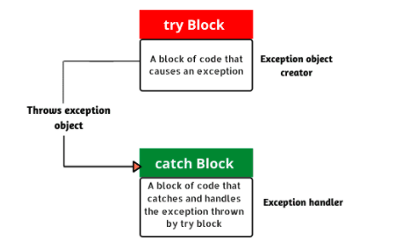
Exception Handling Mechanism
Image source : Google

Slide 19
Exception-Handling Block
try {
// A block of code; // generates an exception }
catch(ExceptionType1 O) {
// Code to be executed when an exception is thrown. } catch(ExceptionType2 O) {
// Code to be executed when an exception is thrown. } finally{
//block of code to be executed after try block ends
}

Slide 20
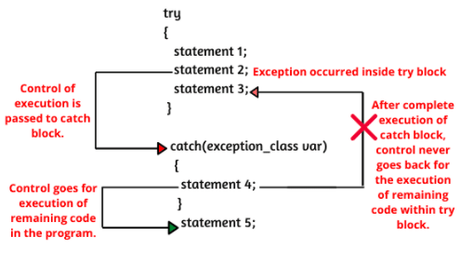
Control Flow of try-catch Block
Image source : Google

Slide 21
Exception Hierarchy
Any exception that when occurs creates an exception object.
Java exceptions which is based on inheritance are hierarchical.
The root class is Throwable which has two child objects i.e Error and Exceptions.
Whereas Exceptions are further categorised into Checked and Unchecked Exception(Runtime Exceptions).

Slide 22
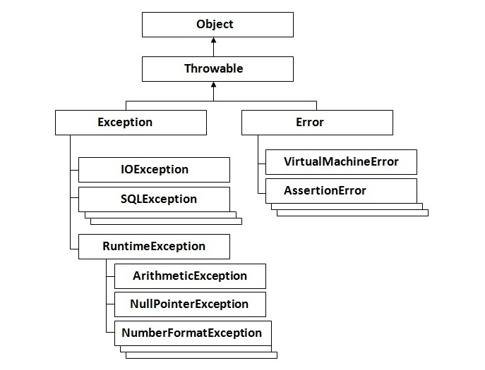
Exception Hierarchy
Image source : Google

Slide 23
Exception Hierarchy
Error:These are out of scope of application and cannot be recovered from them.Out of memory,JVM crash and hardware failure are few conditions.Examples are:OutOfMemoryError and StackOverflowError.
Checked Exceptions:These can be anticipated also can be recovered from using try catch blocks.Examples:IOException,SQLException
Unchecked Exceptions:Can be avoided through better programming, it occurs when trying to fetch an element from an array, before checking the length of an array.Examples: ArithmeticException,NullPointerException etc.

Slide 24
public class JavaException{
public static void main(String args[]){
try{
int data=10/0; //Code that might cause an exception
}catch(ArithmeticException e){System.out.println(e);}
//rest code of the program
System.out.println(“Here we go !!”); }}
Output:java.lang.ArithmeticException: / by zero Here we go !!

Slide 25
Commonly found Exceptions are as follows:
ArithmeticException
Int a=1/0; //ArithmeticException
NullPointerException String s=null; System.out.println(s.length());//NullPointerException
ArrayIndexOutOfBoundsException int a[]=new int[4]; a[8]=100;//ArrayIndexOutOfBoundsException

Slide 26
Throwing and Catching Exception
throw:By using throw statement exception can be thrown explicitly.
Example: class DemoThrow{
static void demo(){ try{throw new NullPointerException(“demo”);}
catch(NullPointerException e){ System.out.println(“Caught inside demo”); throw e;//rethrow the exception}}
Image source : Google

Slide 27
public static void main(String args[])
{
try{
demo();
}
catch(NullPointerException e)
{
System.out.println(“Recaught:” + e);
}}}

Slide 28
The above example showed how to create Java’s standard exception object. Ex:throw new NullPointerException(“demo”)
new is used to construct an instance of NullPointerException.

Slide 29
throws:throws clause lists the types of exception that a method might throw.It cannot handle Error or RuntimeExceptions or their subclasses.
The general form of method declaration :
type method-name(parameter-list)
{
//body of method
}

Slide 30
Example:
Class DemoThrows{ static void throwOne()throws IllegalAccessException{
Throw new IllegalAccessException(“demo”);}
public static void main(String args[]){
try{ throwOne();}catch(IllegalAccessException e){System.out.println(“caught e”); }}}

Slide 31
Output:
Inside throwOne caught java.lang.IllegalAccessException:demo
Firstly needs to have a method which throws the exception.
Secondly main should have a try /catch statement to catch the exception.

Slide 32
finally:The finally block will be executed after a try /catch block has completed and before the code following try/catch block.This block will be executed whether or not an exception is thrown.
Example of finally block:
try{// block of code;}
catch(Exception e){//block of code;}
finally {
//block of code;
}

Slide 33
class FinallyDemo{
public static void main (string[] args)
{
try{
float y=3.2;}
catch(Exception e){System.out.println(e);} finally{System.out.println(“I will get executed no matter what !!”);}}
Output: 3.2 I will get executed no matter what !!

Slide 34
Unreachable catch Block
A block of codes/statements to which control can never reach.
These unreachable blocks are not supported in Java.
This condition arises when multiple catch blocks are used.
The catch blocks should be from most specific to most general i.e.subclass of Exception must be at first and super class be next to it.
try{ //statement} catch(Exception e){ System.out.println(e);} catch(ArithematicException ae)//unreachable block
{System.out.println(ae);}

Slide 35
Stack Trace Elements
Java Stack is composed of frames where each frame contains the state of one Java method invocation.
Each stack frame is represented by StackTraceElement.
The frame at the top of the stack at the zeroth element represents the execution point at which the stack trace was generated.
The last element of the array represents the bottom of the stack.
Throwable.getStackTrace() provides programmatic access to the stack trace information.

Slide 36
import java.lang.*; import java.io.*; import java.util.*; public class StackElementDemo{
Public static void main(String[] arg){ System.out.println(“Class name of each thread involved”); for(int i=0;i<2;i++){ System.out.println(Thread.currentThread().getStackTrace()[i].getClassName());}}}

Slide 37
Class name of each thread involved:
java.lang.Thread StackElementDemo

Slide 38
Exceptions Usage
Exception handling is a powerful mechanism for controlling complex problems arising during runtime.
Cleaner ways to handle failure modes.
For non local branching Java’s exception handling should not be considered.

Slide 39


www.paruluniversity.ac.in

